Slide 1

Exploratory Data Analysis on Pizza Sales
NAME : KAAVYA.S
REG NO : 327150008
PRESENTATION DATE : 10-11-2025

Slide 2
Introduction
The restaurant industry is highly competitive and data-driven decision-making is essential.
This project analyzes pizza sales data using Exploratory Data Analysis (EDA) techniques.
The aim is to identify trends, best and worst-selling pizzas, and factors influencing sales.

Slide 3
Problem Statement
Many restaurants rely on assumptions when pricing or designing menus.
The key question:
Which pizzas sell the best and worst, and why?
Data-driven insights can help make better marketing and pricing decisions.

Slide 4
Objectives
To identify best and worst-selling pizzas.
To analyze how size, price, and category affect sales.
To perform ingredient analysis to find top-selling combinations.
To provide recommendations to improve poorly performing pizzas.

Slide 5
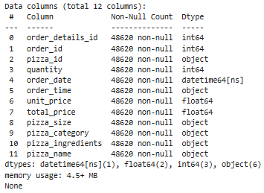
Dataset Description
Source: Pizza restaurant internal sales data (2015). Format: Excel file (Data Model - Pizza Sales.xlsx)
Dataset contains of 48620 rows and 12 columns.
Key Attributes: Pizza name, category, size, unit price, quantity, total sales, ingredients.
Data Cleaning: Handled missing values, validated totals, created new feature total_sales. (817860.05)

Slide 6
Tools and Libraries Used
Python – Core programming language.
Pandas – Data loading, cleaning, and aggregation.
Matplotlib & Seaborn – Visualization and trend analysis.
Scikit-learn – Label Encoding and Linear Regression.
Jupyter Notebook – Interactive analysis and visualization.

Slide 7
Algorithm Used – Linear Regression
Linear Regression was used to study how price, size, and category influence sales quantity.
Used not for prediction, but to validate relationships found during EDA.
Helped quantify how much each factor impacts sales.
Findings: Higher price and larger size reduce sales volume.

Slide 8
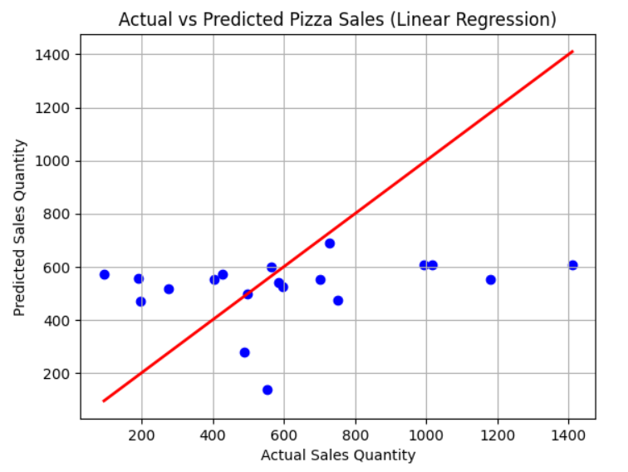
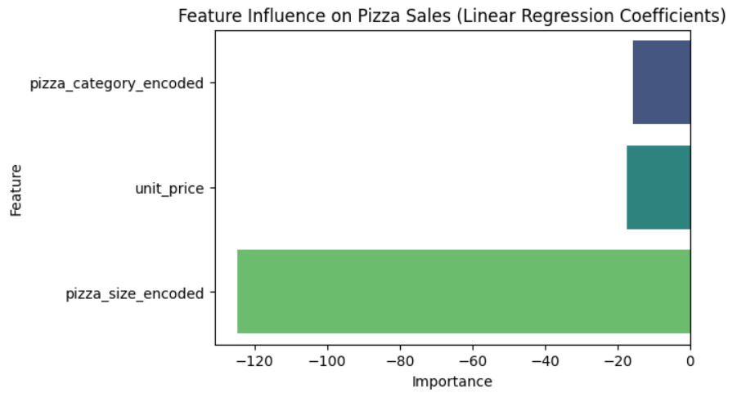
Visualizations

Slide 9
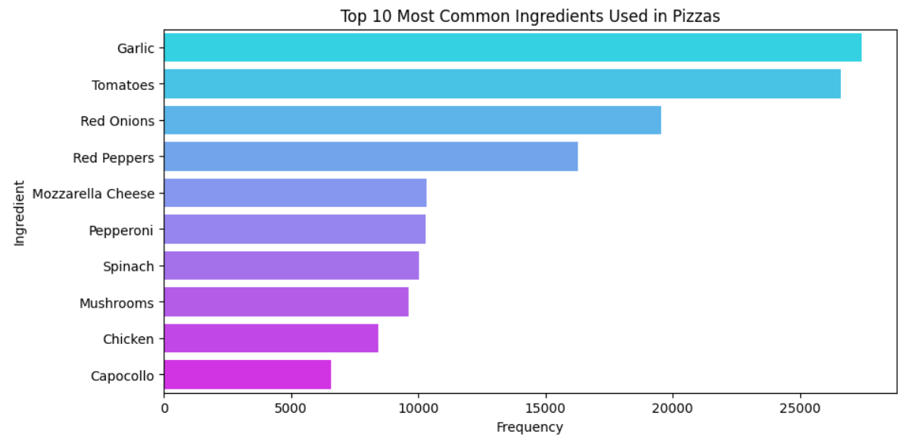
Visualizations

Slide 10
Insights from Analysis
Best Seller: The Big Meat Pizza (Small) – moderate price, popular toppings (mozzarella, garlic, tomatoes).
Least Seller: The Greek Pizza (XXL) – higher price and large size reduce sales.
Smaller & medium pizzas perform better than large or premium ones.
Popular ingredients like mozzarella, garlic, tomatoes boost pizza appeal and sales.

Slide 11
Recommendations
Offer discounts or combos on large pizzas.
Add popular ingredients to low-selling pizzas.
Maintain moderate pricing for consistent sales.
Promote low-selling items (the Greek Pizza, XXL) through better marketing.

Slide 12
Conclusion
EDA revealed that price and size are key factors influencing pizza sales, with smaller and moderately priced pizzas performing best.
Linear Regression validated these findings and provided quantitative insight into how each feature affects demand.
The analysis offered actionable strategies for improving sales, pricing, and menu design.
Future enhancements include seasonal trend analysis, advanced ML models, and a recommendation system for new pizza combinations.

Slide 13
THANK YOU...

